Slide 1
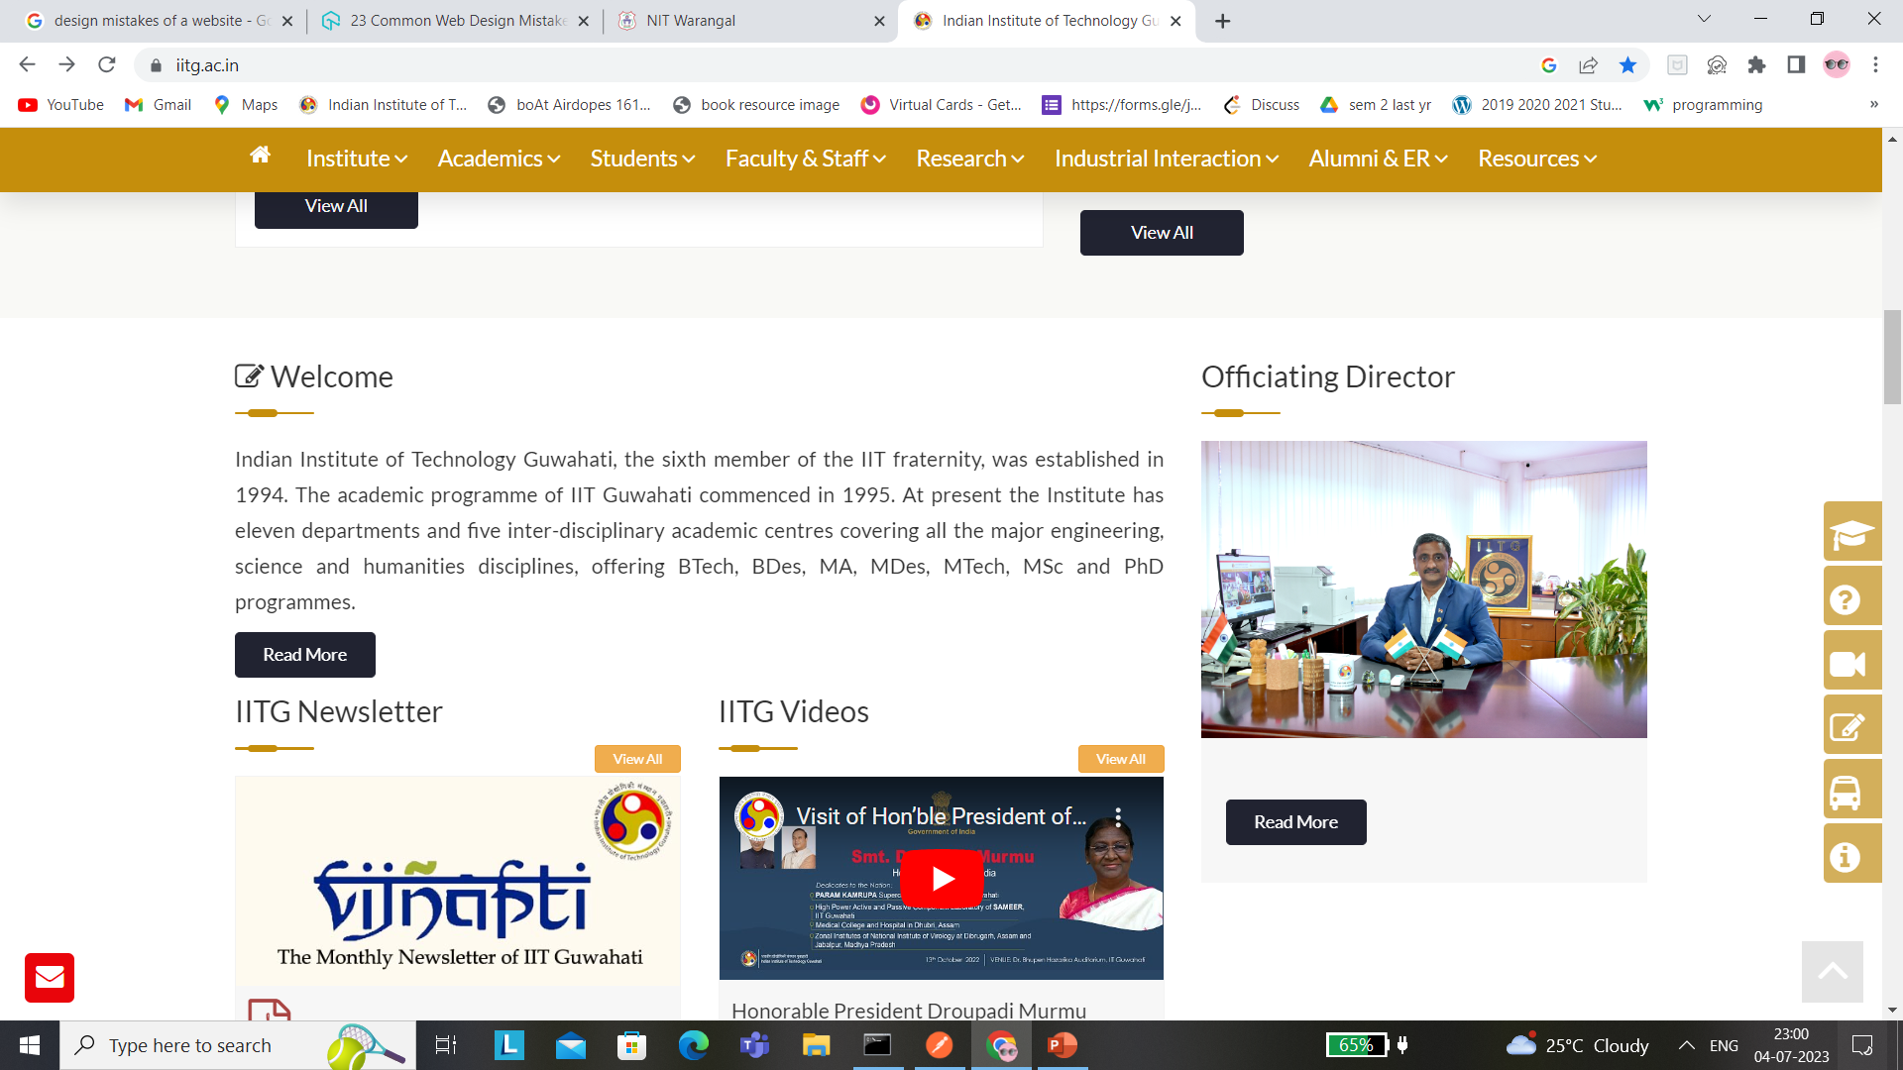
Analysis 1 IIT GUWAHATI (https://www.iitg.ac.in/)
Content Overloaded on the home page, which makes it clumsy and may led to distraction from relevant information’s.

Slide 2
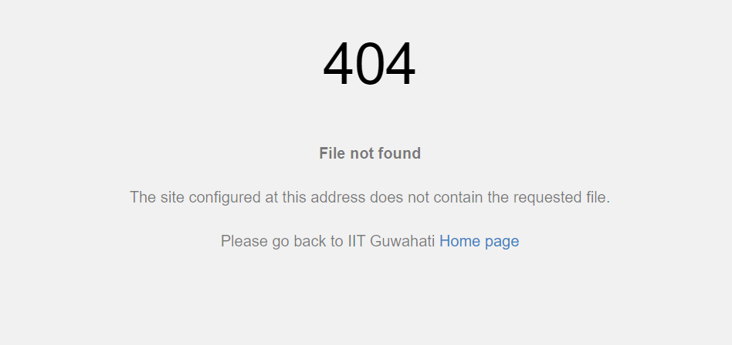
2. Custom 404 page does not exists. Making a custom 404 page can give a better user experience.

Slide 3
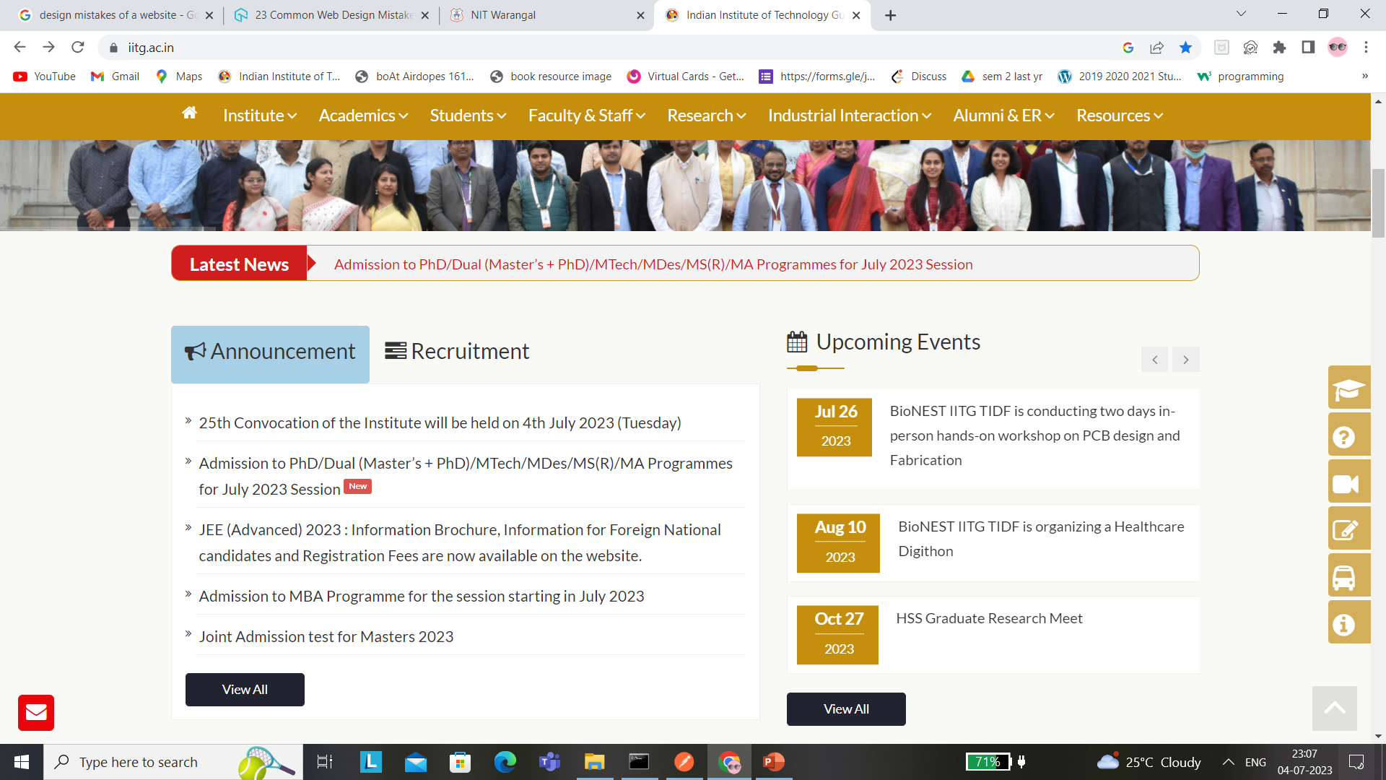
3. Announcement and upcoming events page could have been kept as a sidebar on left side so that its available all over the page. (making it fix, so that important announcements are available throughout the page

Slide 4
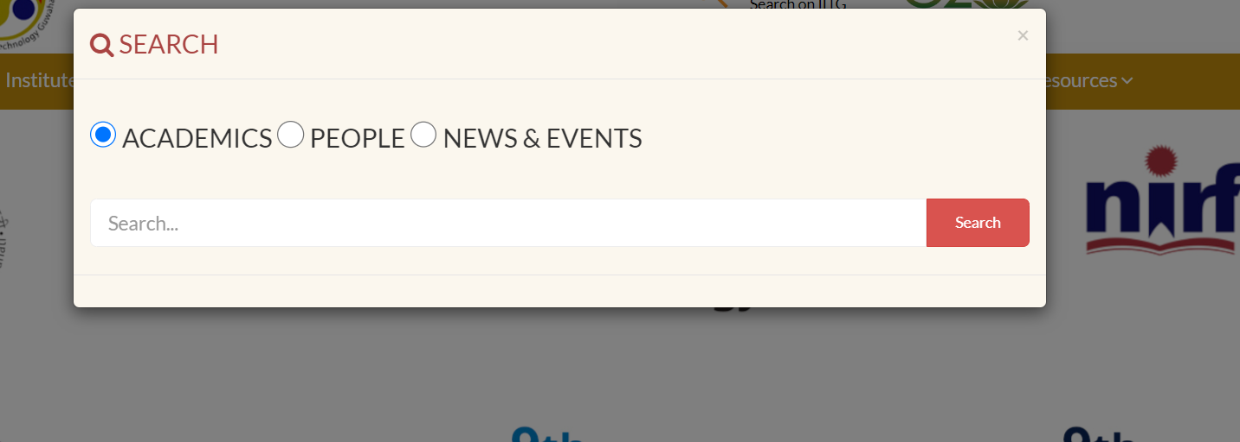
4. Better font size and font style could have been used. And a full text search rather than query parameter based search

Slide 5
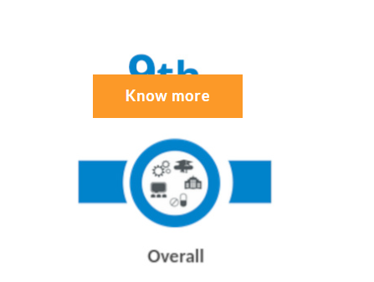
5. Know more button could have been kept at a much better location (overlapping with the text)

Slide 6
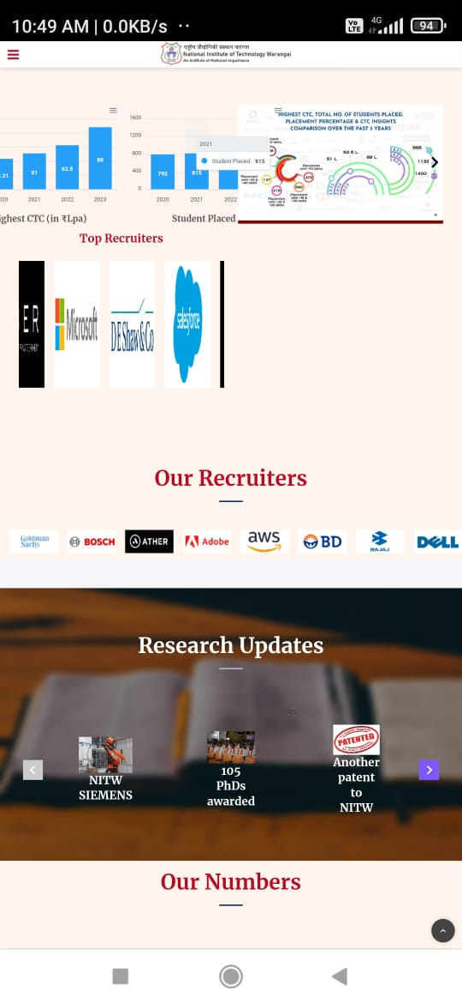
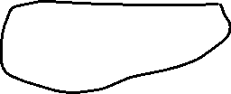
Analysis 2
NIT warangal
https://www.nitw.ac.in/
1. Mismanagement of space and charts are not visible clearly

Slide 7
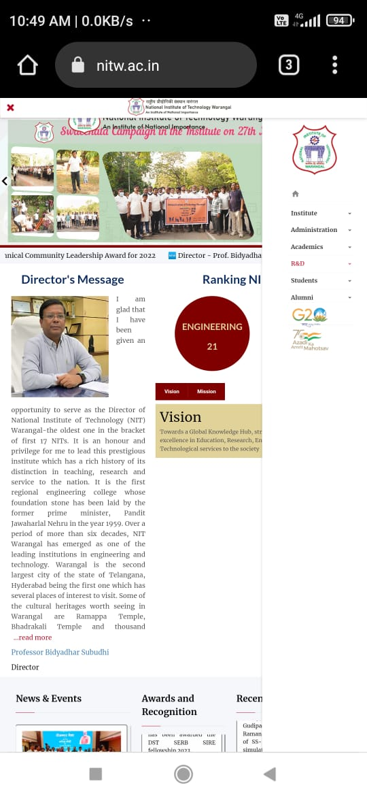
2. Header overlapping with the text and main content.

Slide 8
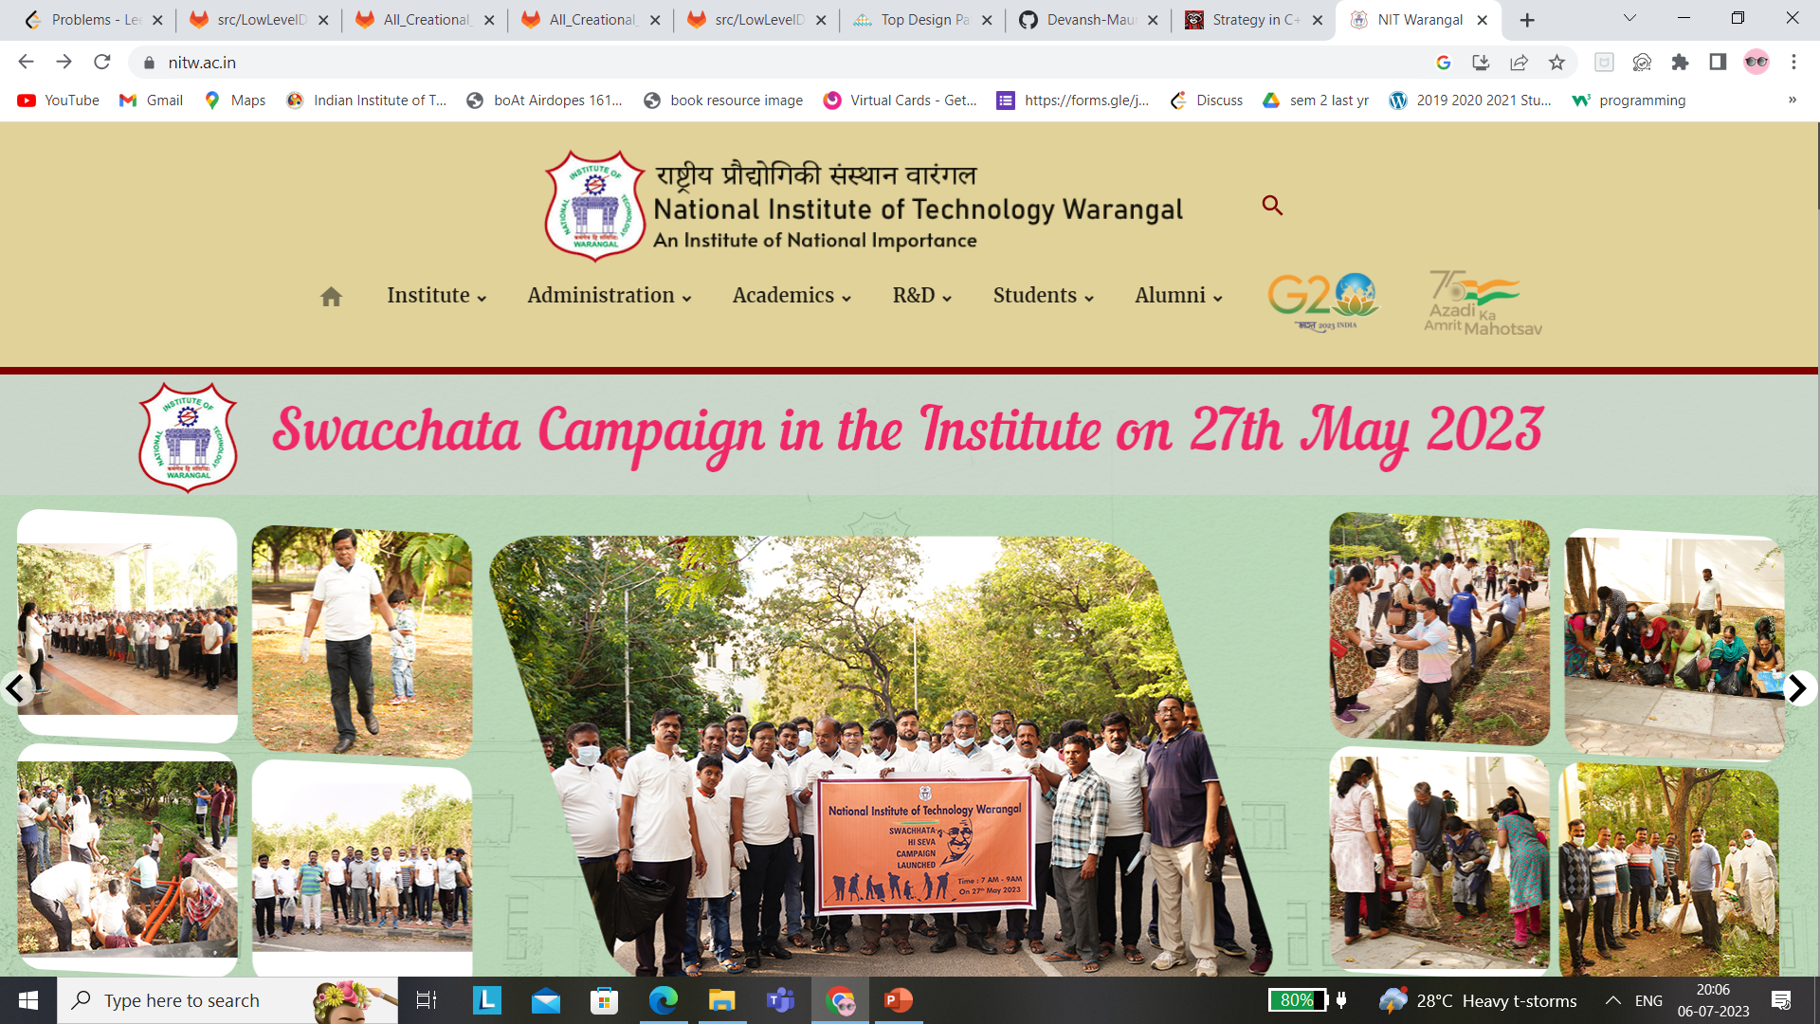
3. Header covering a large percentage of page which might not be required

Slide 9
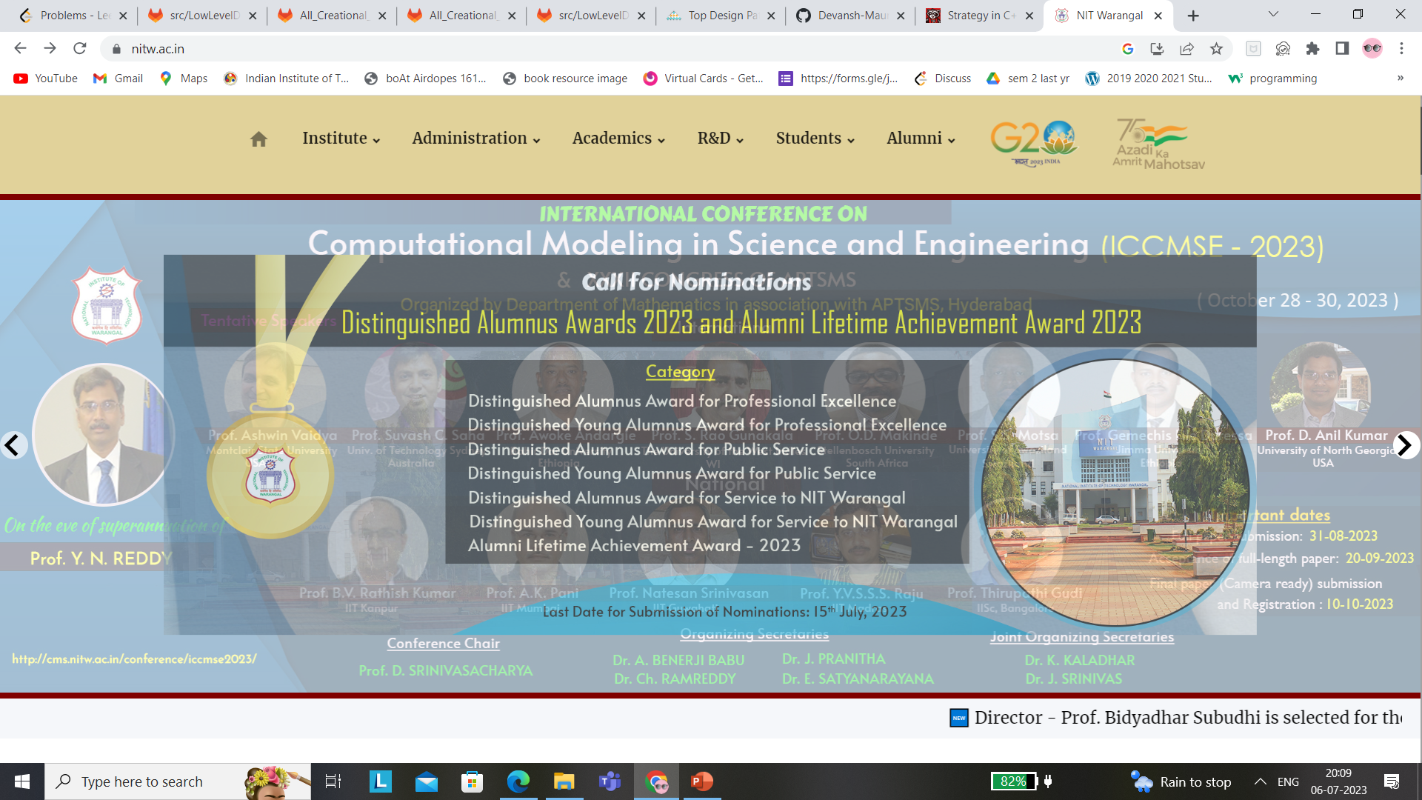
4. Slide transition could have been better than the existing one

Slide 10
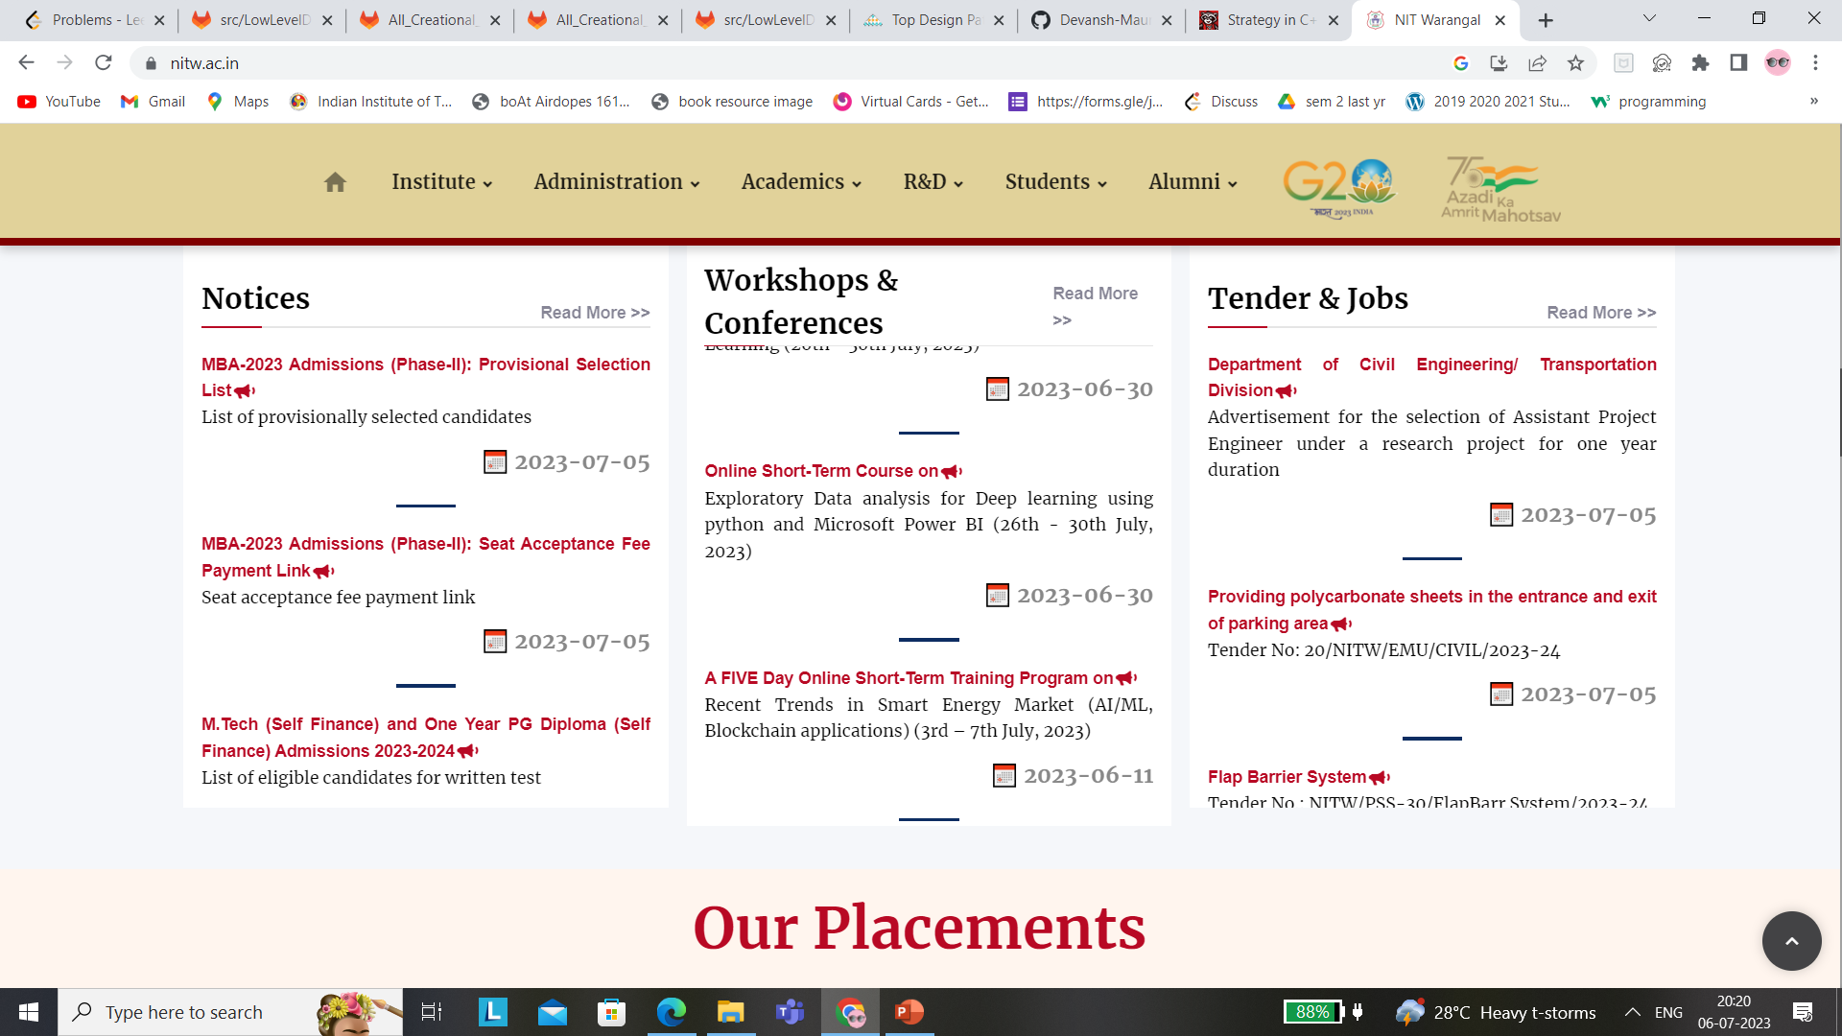

5. While scrolling down if you are at this table location, rather than scrolling down the page it scrolls the content of workshops and conferences.

